Slide 1
A Year in Review
2022

Slide 2
2022 Chamber Executive Committee
Phil Henry, President
Karen Raisch-Siegel, 1st Vice President
Past President/Advisor, Tim Noe
Treasurer, Tim Cooper
Executive Director, Claudia Motiu

Slide 3
2022 Chamber Board Members
Charles Bichara, City of Middleburg Hts.
Dan Sage, Machor Sage Insurance
Dave Herwerden, WestPoint Wealth Management
Doug Miller, Polaris Career Center
Edvige Rita Camardo, Key Bank
Geoffrey Dennis, Dollar Bank
Jennifer Gosnell, Dollar Bank
John Grech, Edward Jones
John Hausman, Cuyahoga Community College
Kim Harris, Pathway Caring for Children
Mike Tomon, Tomon & Sons Funeral Home
Shelley Chornak, Sage Partners

Slide 4
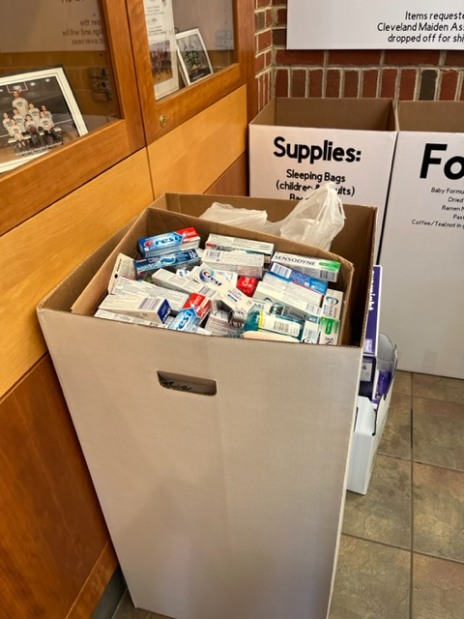
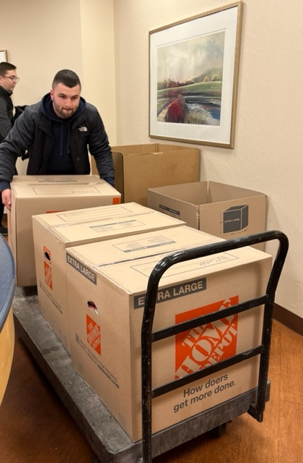
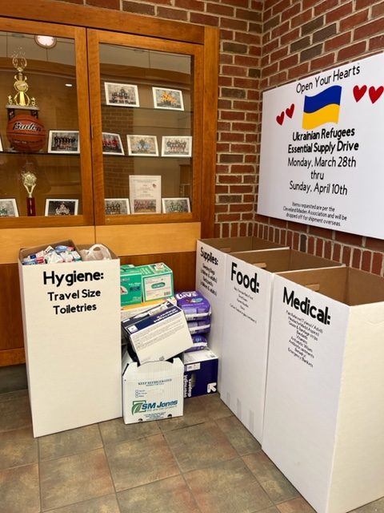
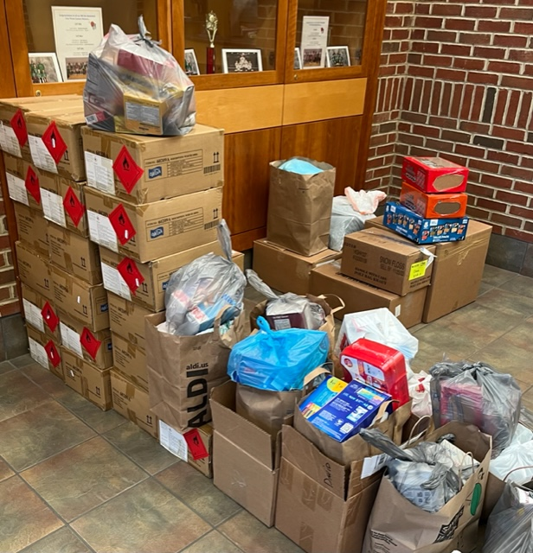
March – Supply Drive Ukrainian Relief Drive – Partnered with Middleburg Hts. Recreation Center

Slide 5
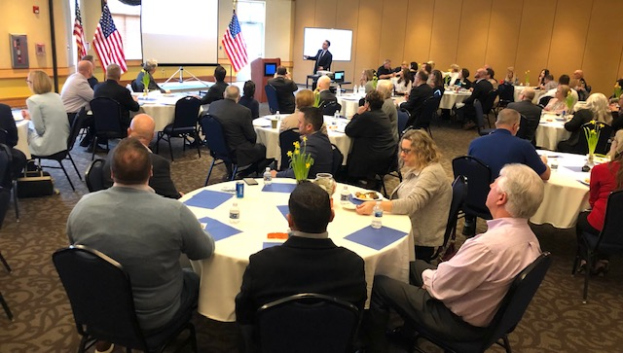
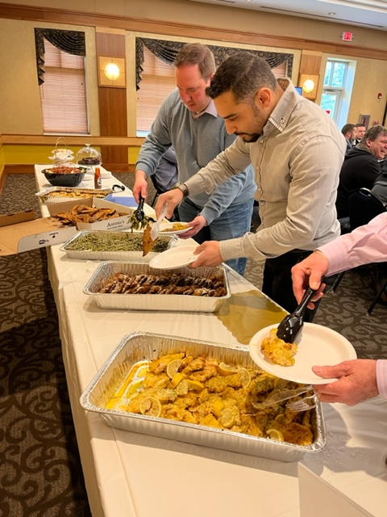
April Luncheon State of the City

Slide 6
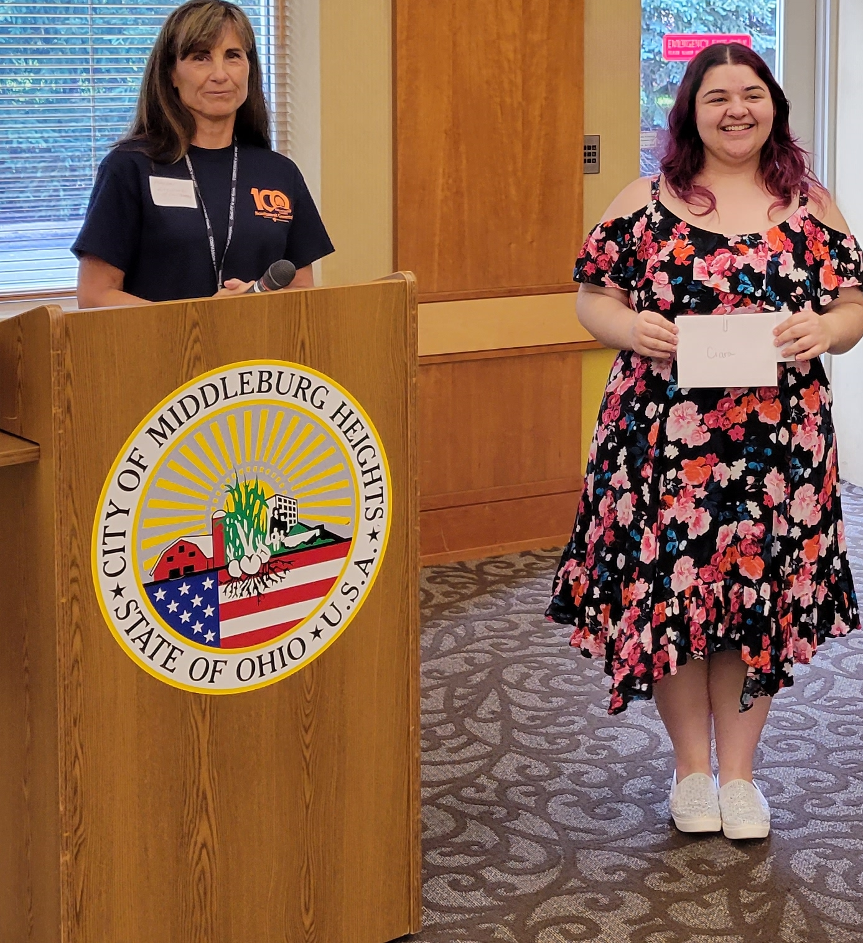
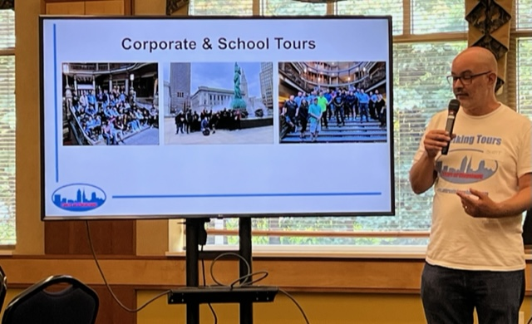
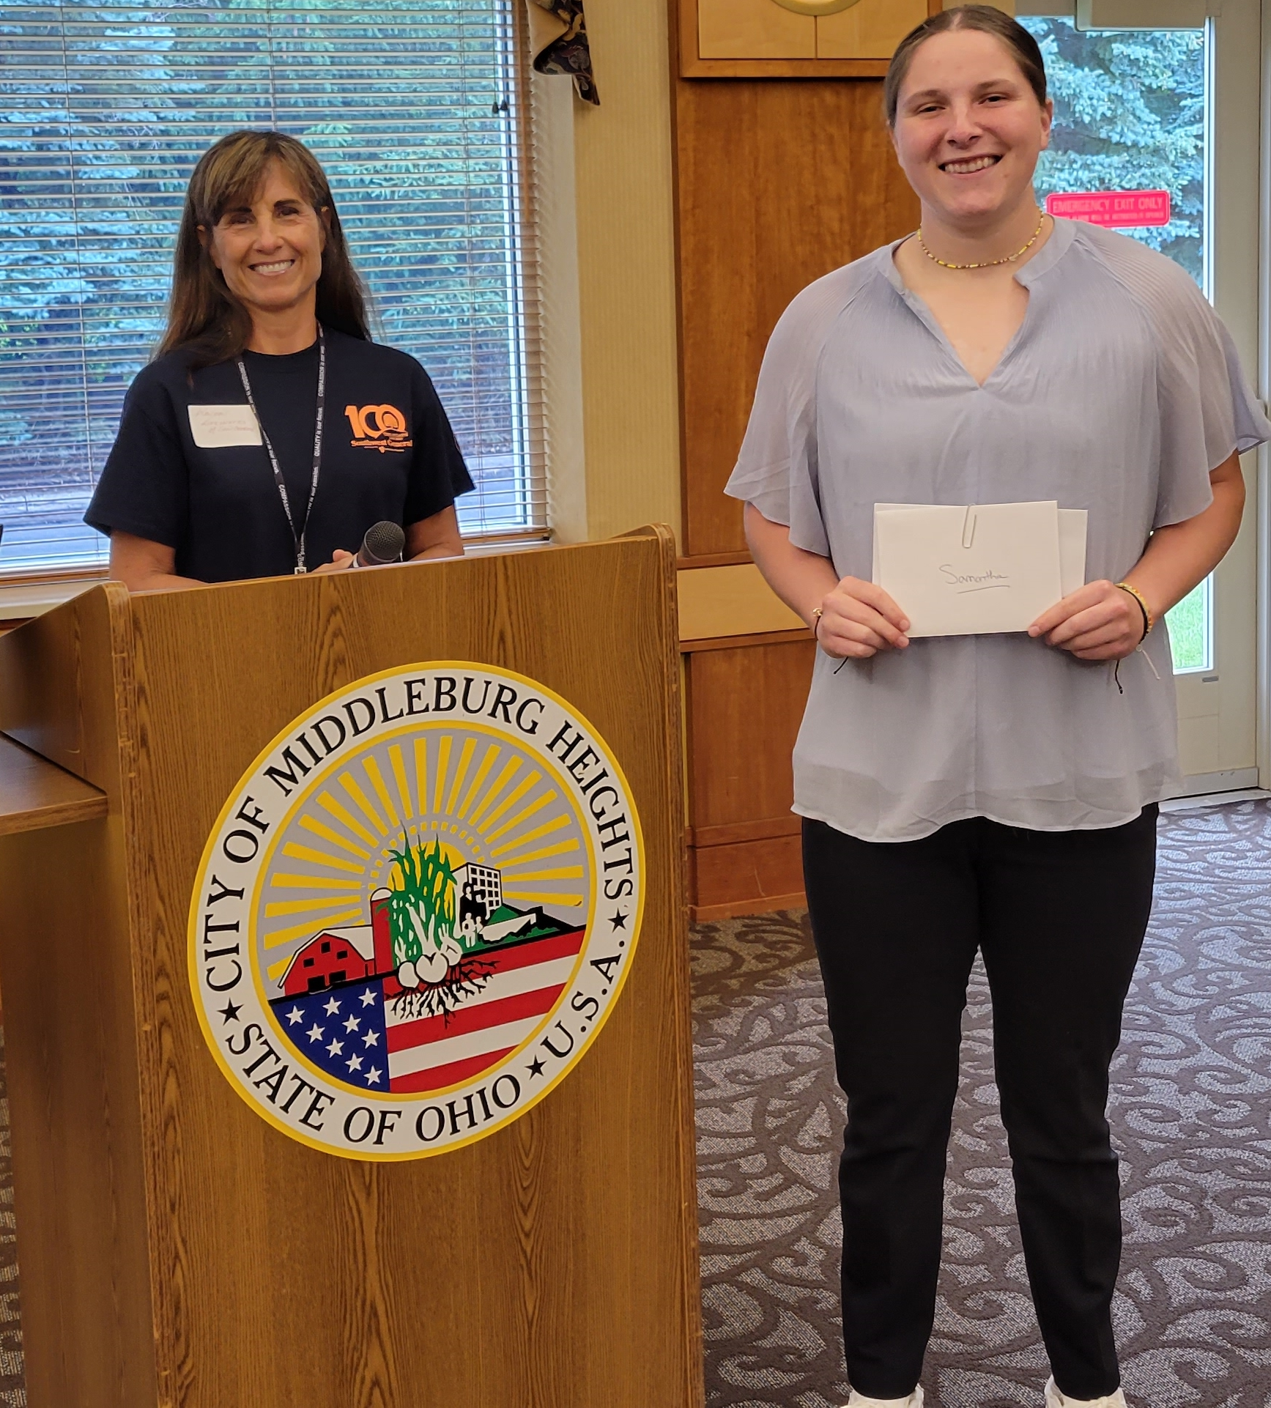
June Luncheon -
Staycation Hidden Gems & Scholarship Awards

Slide 7
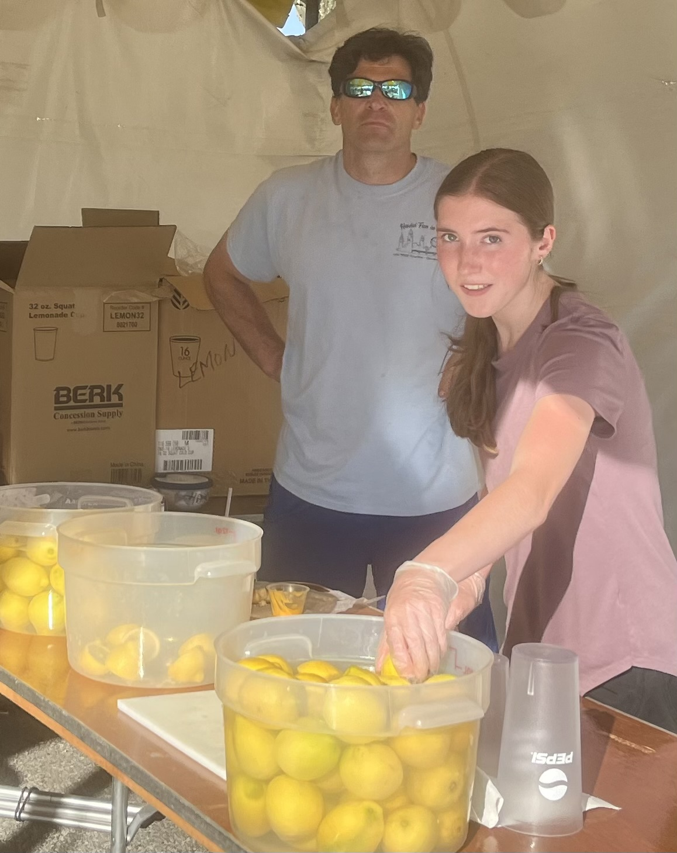
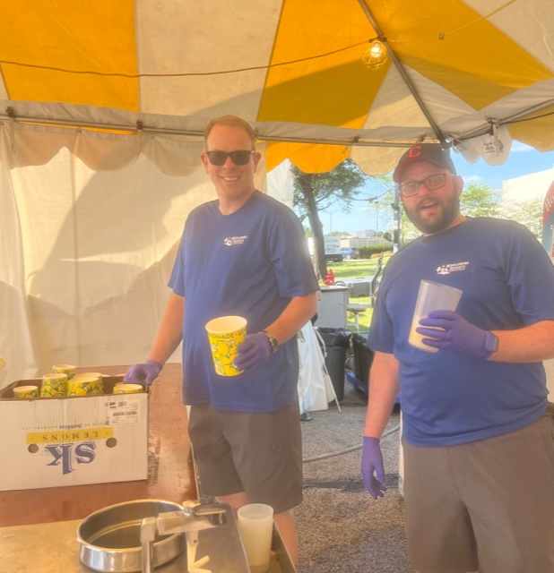
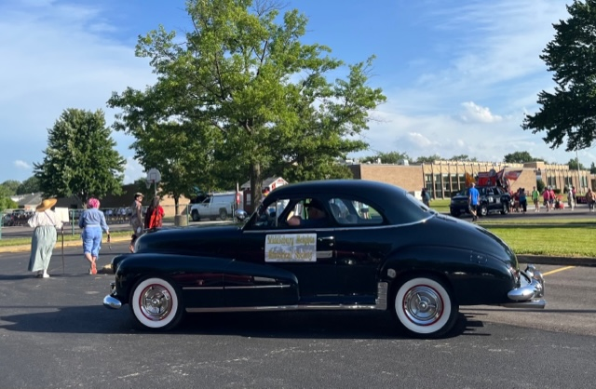
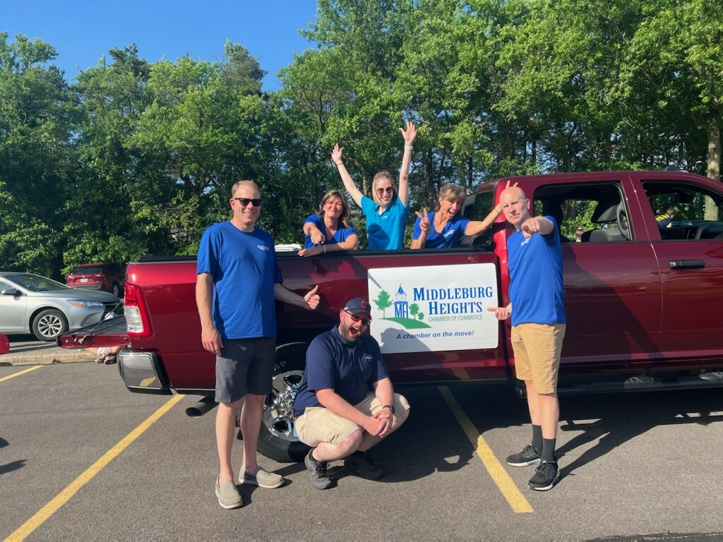
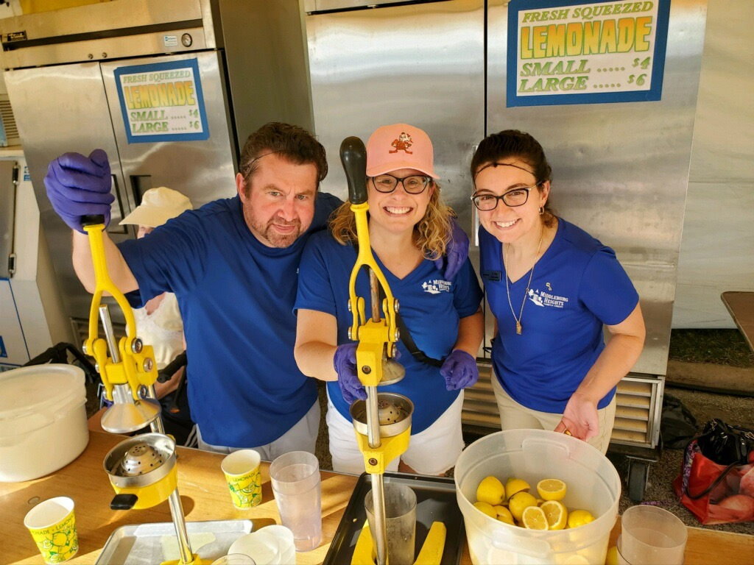
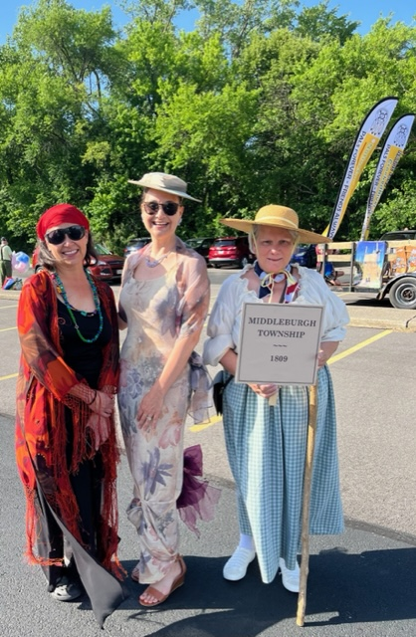
June
Summer in the City,
Parade & Lemonade Stand

Slide 8
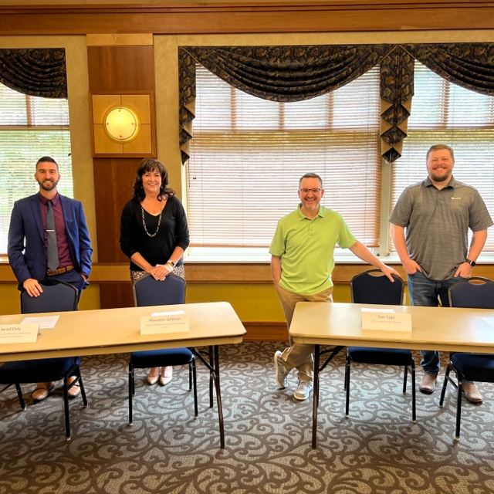
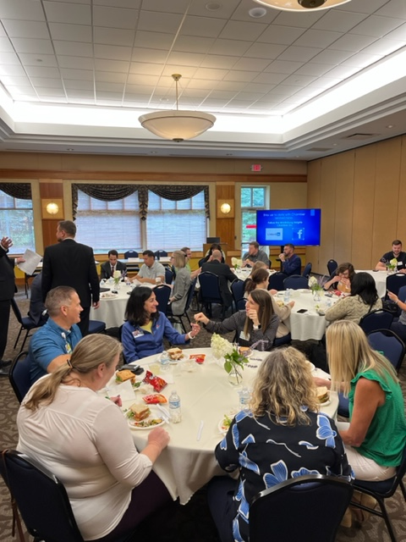
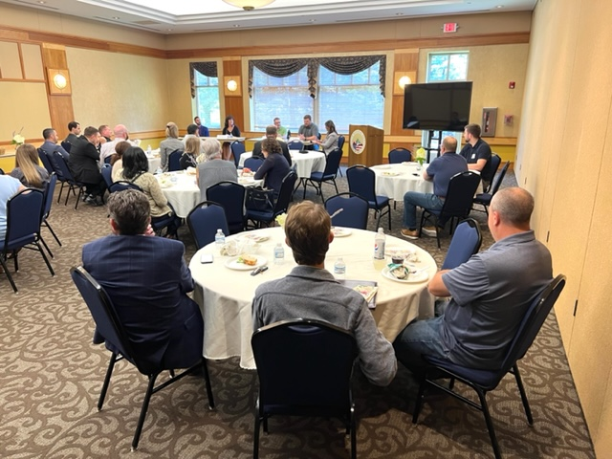
August Luncheon – Creative Hiring and Recruitment Panel

Slide 9
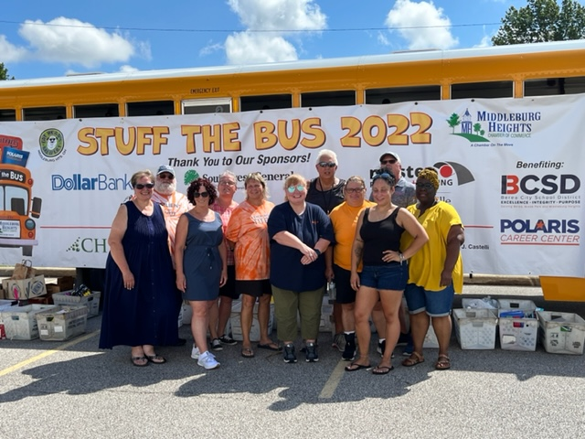
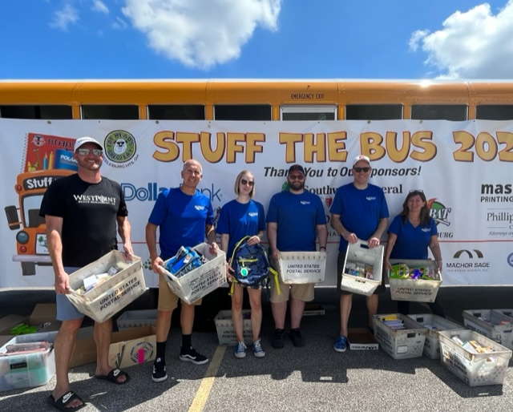
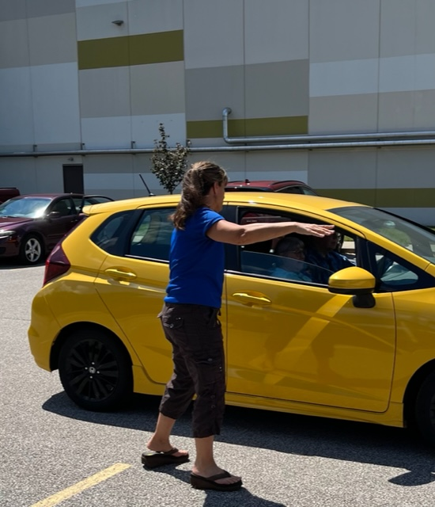
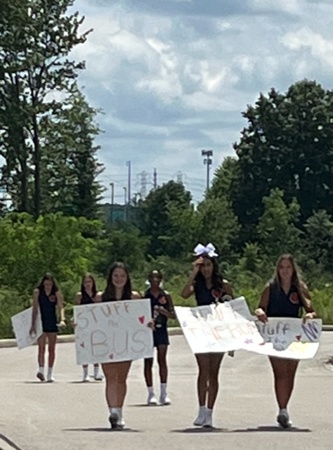
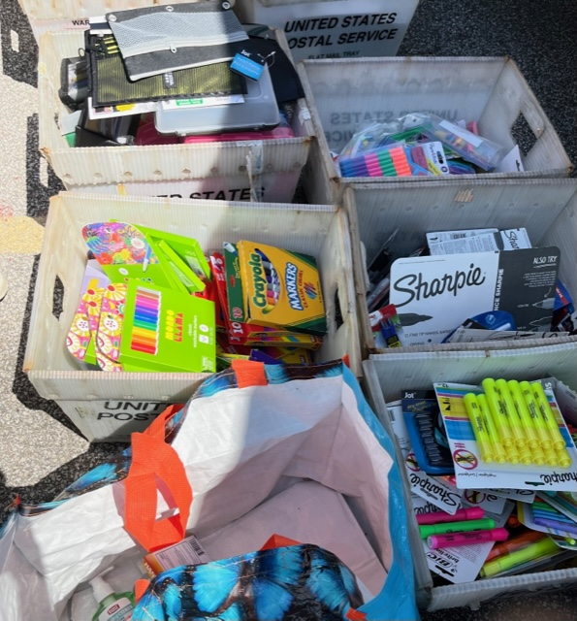
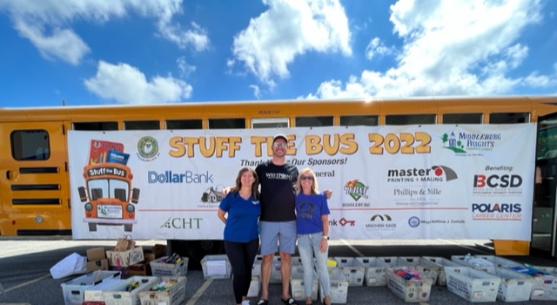
August
Stuff the Bus

Slide 10
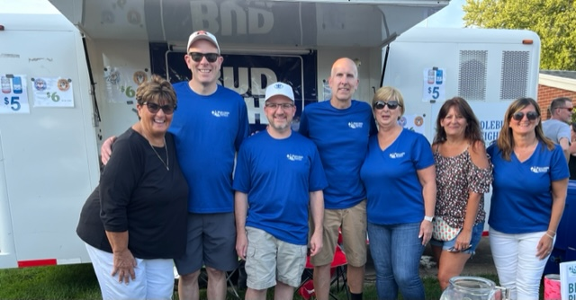
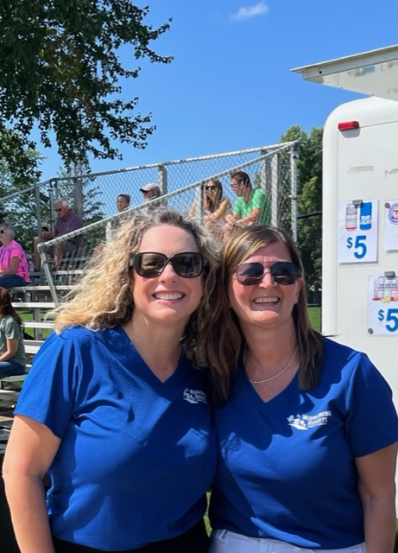
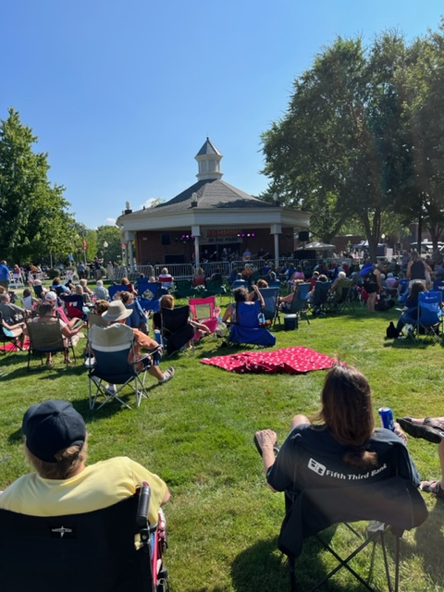
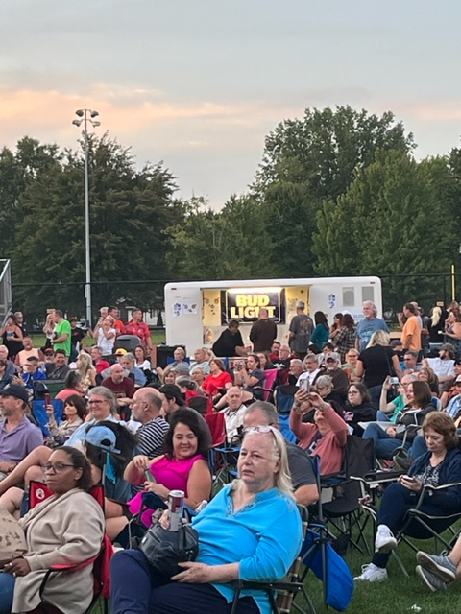
August
Jammin’ in the Park

Slide 11
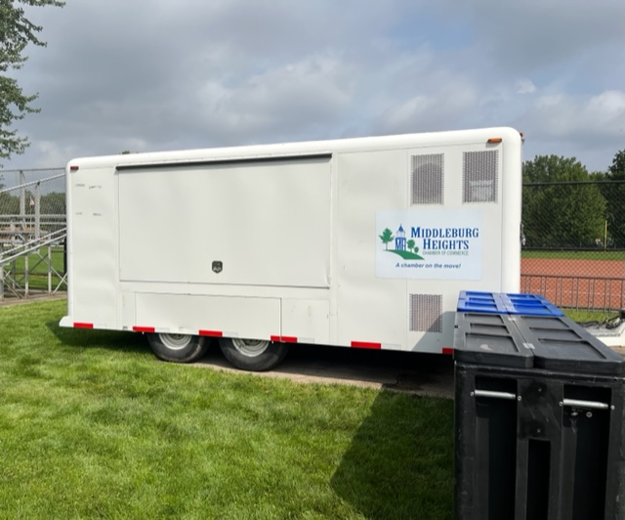
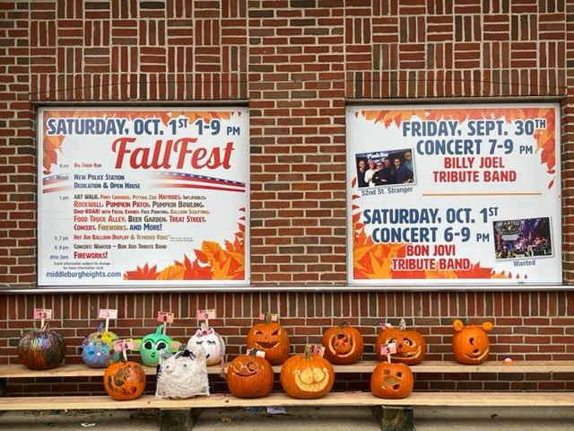
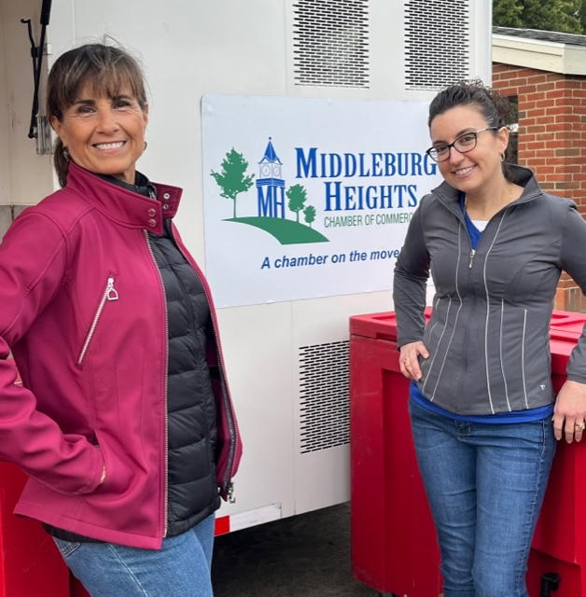
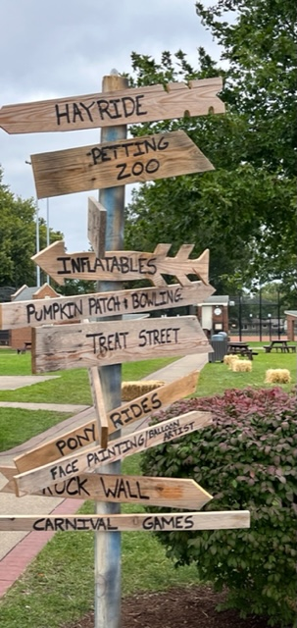
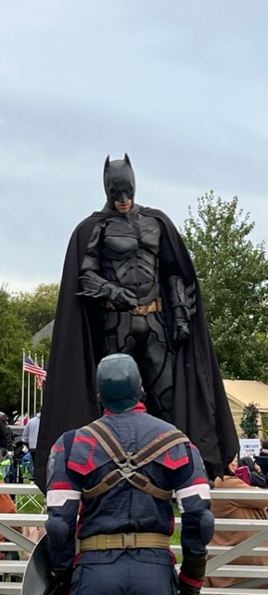
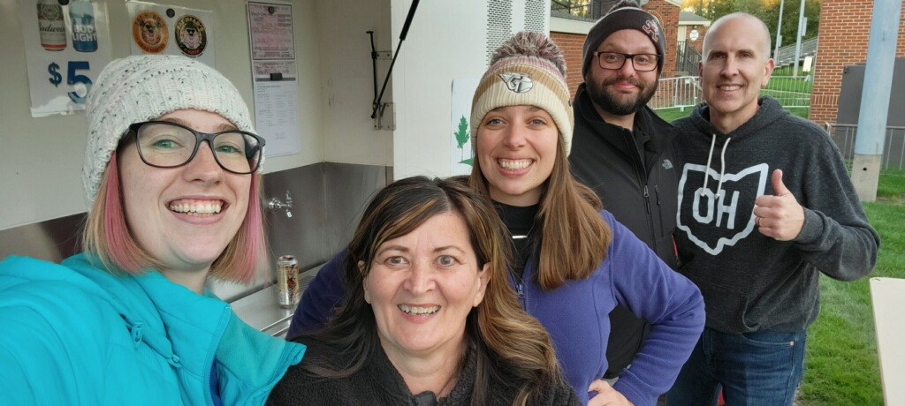
September 2022 – Fall Fest

Slide 12
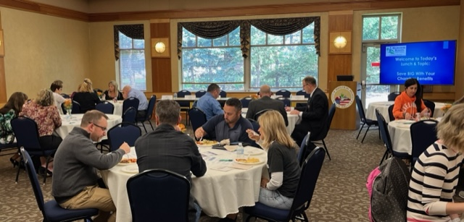
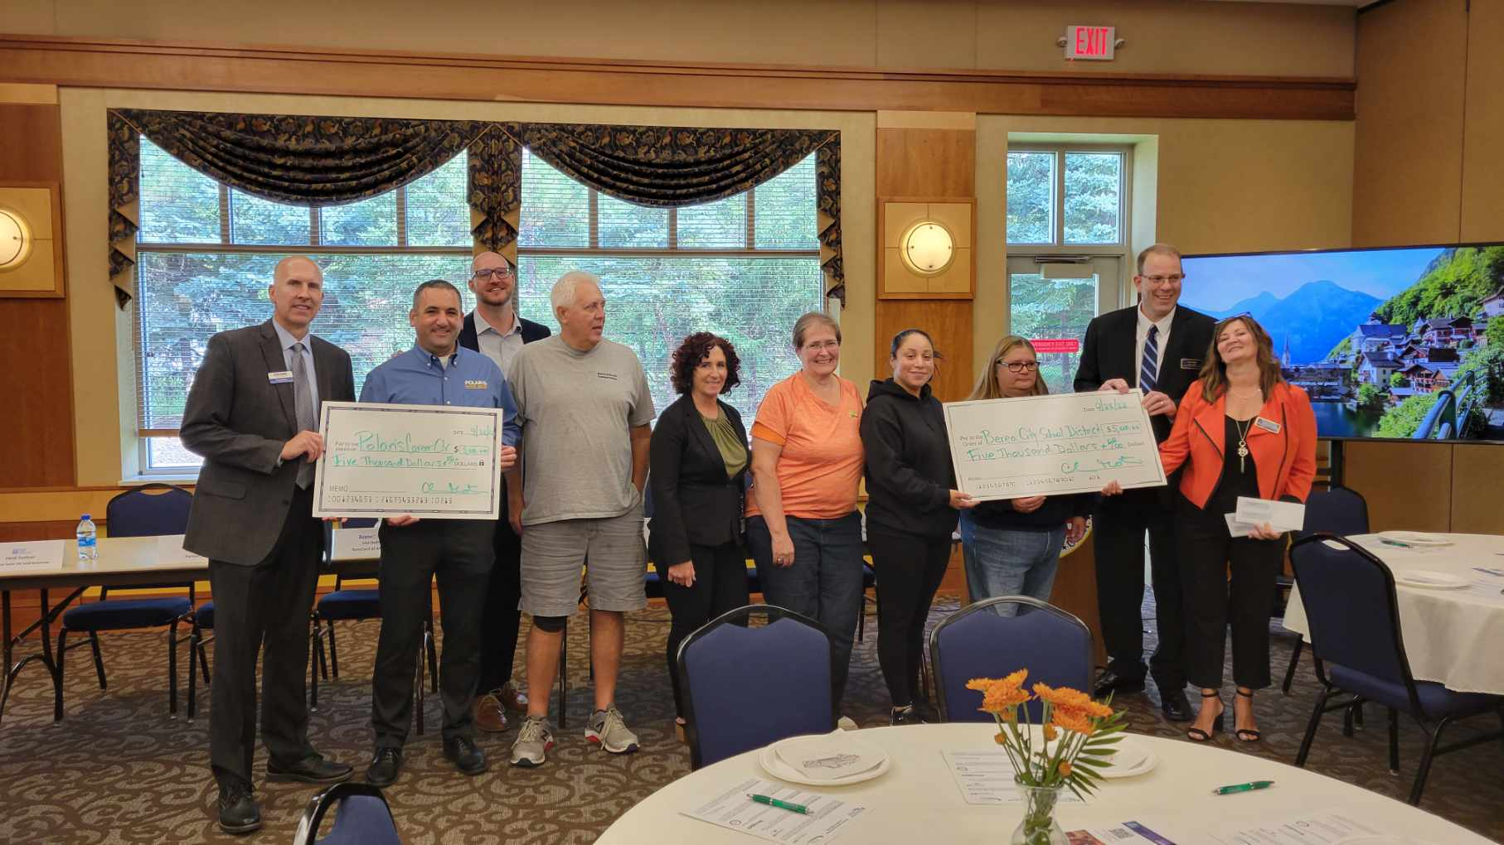
September Luncheon - Saving BIG with Chamber Benefits & Stuff the Bus check award

Slide 13
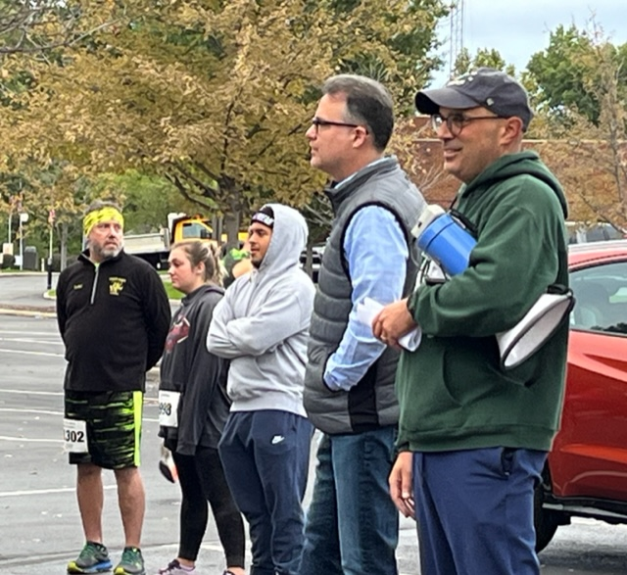
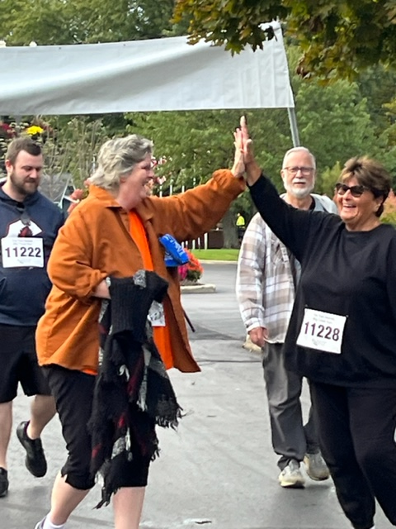
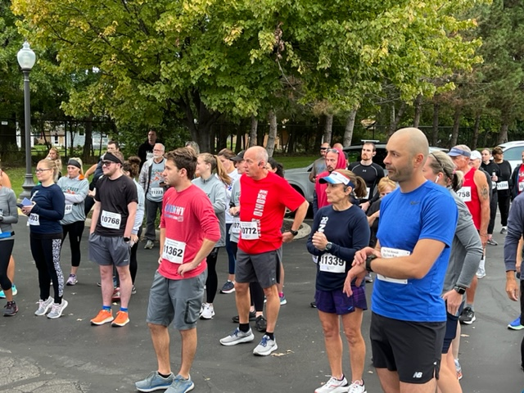
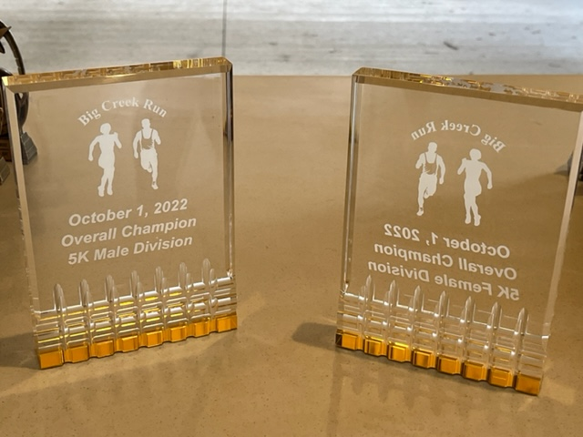
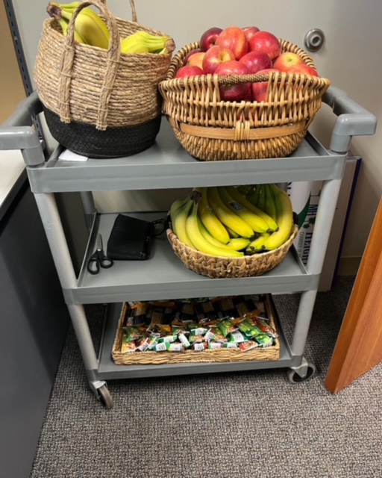
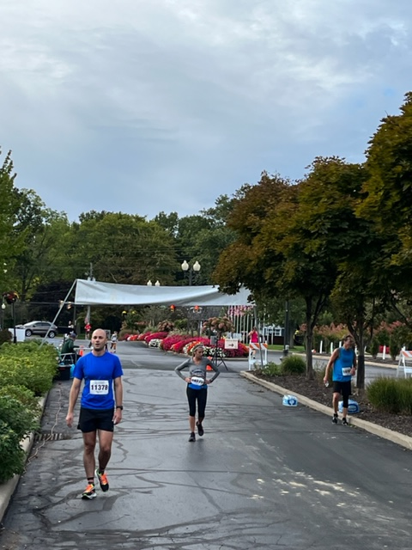
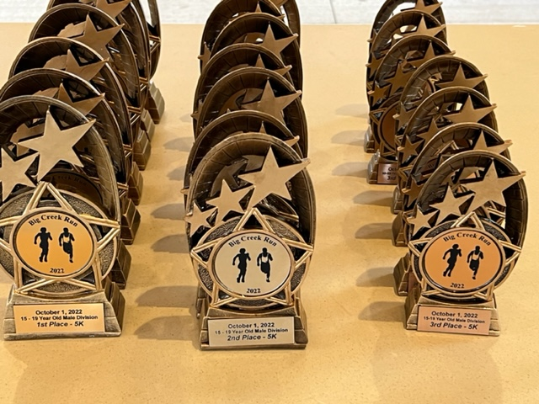
October
Big Creek Run

Slide 14
1st Chamber Morning Meet Up
October

Slide 15
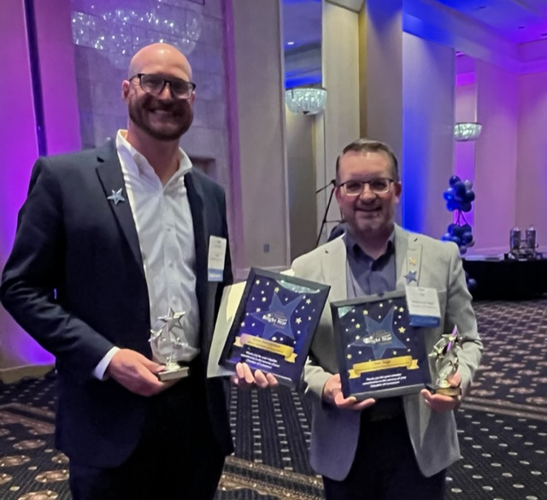
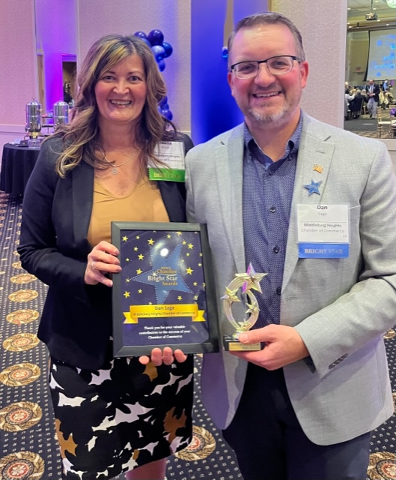
Bright Star Awards Ceremony
October
Dan Sage Bright Star for Middleburg Hts.
&
Dave H. Bright Star for Berea Chamber of Commerce

Slide 16
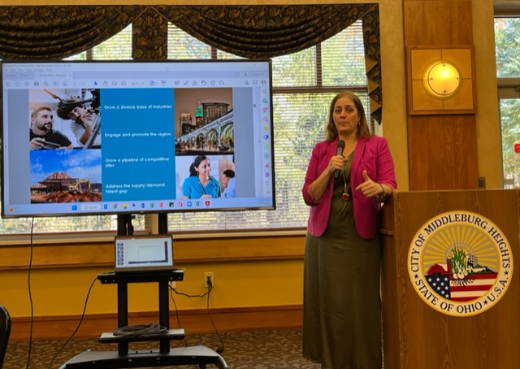
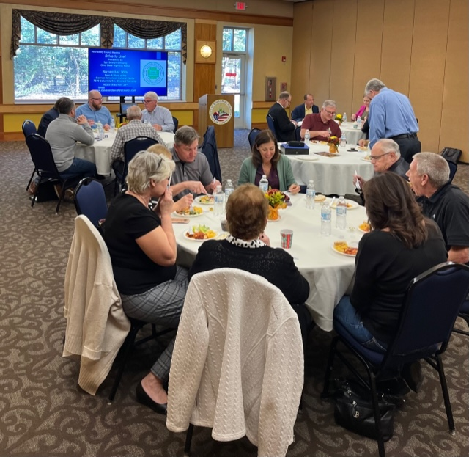
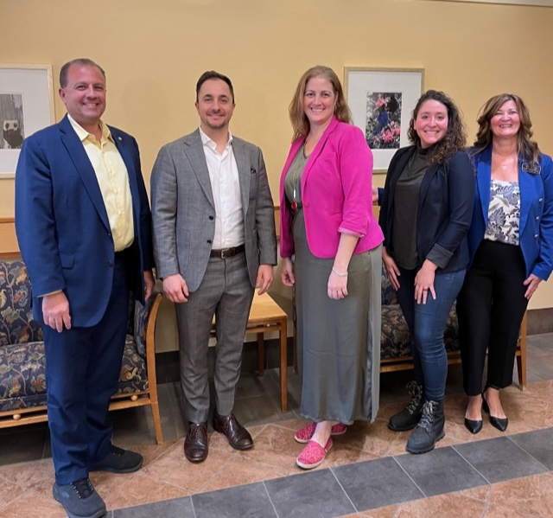
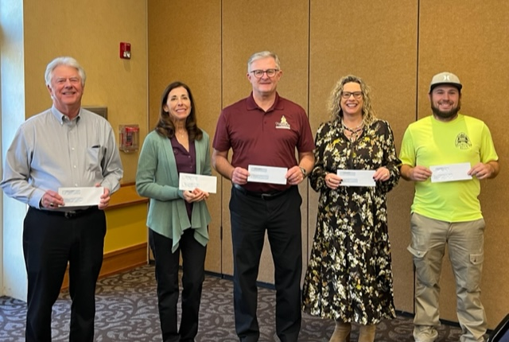
November Luncheon – Growing Northeast Ohio’s Economy

Slide 17
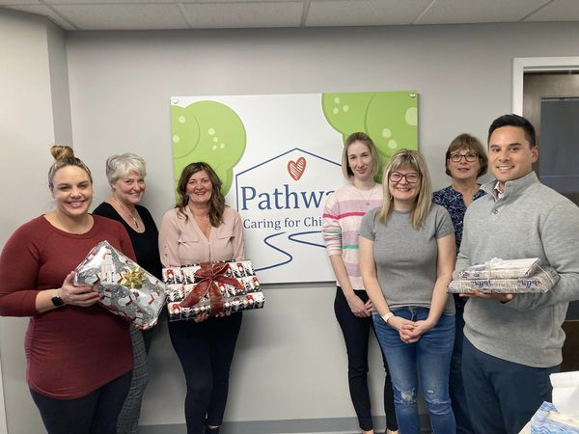
November – Toy Drive for Foster Children

Slide 18
Ribbon Cuttings

Slide 19
Board of Director’s Meetings –
Offsite at Chamber Member locations

Slide 20
12 months
$13k+ donated to non-profits/charities
$2k in scholarships awarded to two students
Thousands of supplies donated for relief supply drive
250 Chamber members – we are in the top 1/3 of NOACC chamber membership
144 Toys donated by chamber members, historical society & Lifeworks as part of Toy Drive
20 New Chamber members (non repeat)
12 Chamber newsletters released with 46% open rate
10 Chamber lunches (lunch and learn) held
8 Local organizations and two schools supported
5 charitable events (Stuff the Bus, Scholarships, BCR, Toy Drive, Relief Drive)
4 ribbon cuttings
3 revenue generating events (2 Beer Gardens, 1 Lemonade Stand)
1 Chamber Morning Meet Up - NEW

